Slide 1

SE-3002 Software quality engineering Rubab Jaffar rubab.jaffar@nu.edu.pk
Part IV-QUANTIFIABLE QUALITY IMPROVEMENT
Feedback Loop and Activities for Quantifiable Quality Improvement
Lecture # 36
9 Dec
Notes:
Hi Raghvendra, good to know about you. My Selenium WebDriver with Java tutorial for beginner is available at- https://youtu.be/2SzdhH8xAX4

Slide 2
Today’s Outline
Feedback Loop and Activities for Quantifiable Quality Improvement
Feedback Loop and Overall Mechanism
Monitoring and Measurement
Analysis and Feedback
Tool and Implementation Support
Notes:
Chapter 14 SQA by Jeff Tian

Slide 3
quantifiable quality improvement basic elements
Part IV is quantifiable quality improvement, which includes two basic elements:
Quantification of quality through quantitative measurements and models so that the quantified quality assessment results can be compared to the pre-set quality goals for quality and process management.
Quality improvement through analyses and follow-up activities by identifying quality improvement possibilities, providing feedback, and initiating follow-up actions.

Slide 4
quantifiable quality improvement
To support quantifiable quality improvement, various parallel and follow-up activities to the main quality assurance (QA) activities are needed, including:
Monitoring the specific QA activities and the overall software development or maintenance activities, and extracting relevant measurement data.
Analyzing the data collected above for quality quantification and identification of quality improvement opportunities.
Providing feedback to the QA and development/maintenance activities and carrying out follow-up actions based on the analysis results above.

Slide 5
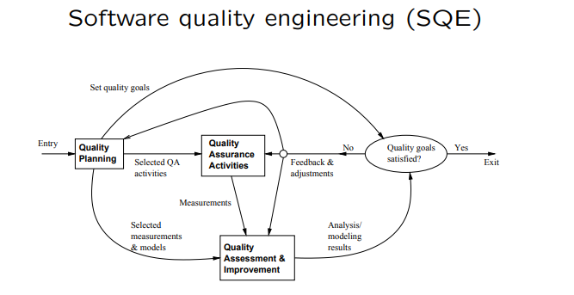
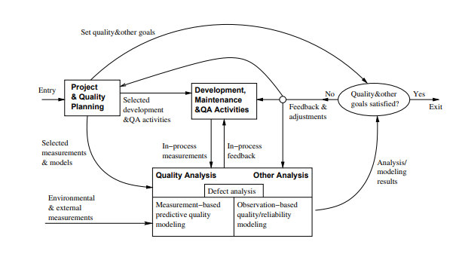
quantifiable quality improvement
These activities also close the quality engineering feedback loop discussed in part I and refine it into Following:
Notes:
- in-process measurements from the QA activities as well as the related development/maintenance activities;
- environmental measurements about the overall project environment and external measurements beyond the project scope.

Slide 6
Importance of Feedback Loop
All QA activities covered in Part II and Part III need additional support: .
Planning and goal setting
Management via feedback loop
When to stop?
Adjustment and improvement, etc.
All based on assessments/predictions

Slide 7
Importance of Feedback Loop
Feedback loop for quantification/improvement: i.e. Focus of Part IV
mechanism and implementation
models and measurements.
defect analyses and techniques
risk identification techniques
software reliability engineering

Slide 8
QE Activities and Process Review
Major activities:
Pre-QA planning (Part I)
QA (Part II and Part III)
Post-QA analysis & feedback – Part IV (maybe parallel instead of “post-”)

Slide 9
QE Activities and Process Review
Feedback loop zoom-in:
Multiple measurement sources.
Many types of analysis performed.
Multiple feedback paths.

Slide 10
Feedback Loop Related Activities
Monitoring and measurement: .
defect monitoring ∈ process management
defect measurement ∈ defect handling
many other related measurements.
Analysis modeling:
Historical baselines and experience
Choosing models and analysis techniques
Focus on defect/risk/reliability analyses
Goal: assessment/prediction/improvement.
Feedback and follow-up
Frequent feedback: assessment/prediction
Possible improvement areas identified
Overall management and improvement.

Slide 11
Quality Monitoring and Measurements
Quality monitoring needs:
Quality as a quantified entity over time
Able to assess, predict, and control
Various measurement data needed
Some directly in quality monitoring
Others via analyses to provide feedback.
Direct quality measurements:
Result, impact and related info. e.g., success vs. failure
Defect information: directly monitored.
Mostly used in quality monitoring.

Slide 12
Indirect Quality Measurements
Indirect quality measurements: Why?
Other quality measurements (reliability) need additional analyses/data.
Unavailability of direct quality measurements early in the development cycle ⇒ early (indirect) indicators.
Used to assess/predict/control quality. (to link to or affect various direct quality measurements)
Types of indirect quality measurements:
Environmental measurements.
Product internal measurements.
Activity measurements.

Slide 13
Indirect Measurements: Environment
Process characteristics
Entities and relationships
Preparation, execution and follow-up
Techniques used
People characteristics
Skills and experience
Roles: planners/developers/testers
Process management and teams
Product characteristics
Product/market environment
Hardware/software environment

Slide 14
Indirect Measurements: Internal
Product internal measurements: most studied/understood in SE
Software artifacts being measured:
Mostly code-related
Sometimes SRS, design, docs etc.
Product attributes being measured:
Control: e.g., McCabe complexity
Data: e.g., Halstead metrics
Presentation: e.g., indentation rules
Notes:
Structures:
Unstructured: e.g., LOC
Structured: examples above

Slide 15
Indirect Measurements: Activity
Execution/activity measurements:
Overall: e.g., cycle time, total effort.
Phased: profiles/histograms.
Detailed: transactions
Testing activity examples:
Timing during testing/usage
Path verification (white-box)
Usage-component mapping (black-box)
Measurement along the path
Usage of observations/measurements: observation-based and predictive models

Slide 16
Immediate Follow-up and Feedback
Immediate (without analyses): Why?
Immediate action needed right away:
critical problems ⇒ immediate fixing
most other problems: no need to wait
Some feedback as built-in features in various QA alternatives and techniques.
Activities related to immediate actions.
Testing activity examples:
Shifting focus from failed runs/areas.
Re-test to verify defect fixing.
Other defect-related adjustments.
Defect and activity measurements used.

Slide 17
Analyses, Feedback, and Follow-up
Most feedback/followup relies on analyses.
Types of analyses:
Product release decision related.
For other project management decisions, at the phase or overall project level.
Longer-term or wider-scope analyses.
Types of feedback paths:
Shorter vs. longer feedback loops.
Frequency and time duration variations.
Overall scope of the feedback.
Data source refinement.
Feedback destinations.

Slide 18
Analysis for Product Release Decisions
Most important usage of analysis results
Prominent in SQE and modified SQE Figure
Related to: “when to stop testing?”
Basis for decision making:
Without explicit quality assessment:
implicit: planned activities,
indirect: coverage goals,
other factors: time/$-based.
With explicit quality assessment:
failure-based: reliability,
fault-based: defect count & density.
Criteria preference:
reliability – defect – coverage – activity.

Slide 19
Analyses for Other Decisions
Transition from one (sub-)phase to another:
Later ones: similar to product release.
Earlier ones: reliability undefined
defects – coverage – activity,
inspection and other early QA
Other decisions/management-activities:
Schedule adjustment.
Resource allocation and adjustment.
Planning for post-release support.
Planning for future products or updates.
These are product-level or sub-product-level decisions and activities

Slide 20
Other Feedback and Followup
Other (less frequent) feedback/followup:
Goal adjustment (justified/approved).
Self-feedback (measurement & analysis)
Longer term, project-level feedback.
May even carry over to followup projects.
Beyond a single-project duration/scope:
Future product quality improvement
overall goal/strategy/model/data,
especially for defect prevention.
Process improvement.
More experienced people

Slide 21
Feedback Loop Implementation
Key question: sources and destinations. (Analysis and modeling activity at center.)
Sources of feedback loop = data sources:
Result and defect data:
the QA activities themselves.
Activity data:
both QA and development activities.
Product internal data: product. (produced by development activities)
Environmental data: environment.
Additional sources of feedback loop:
From project/QA planning.
Extended environment: measurement data and models beyond project scope.

Slide 22
Feedback Loop Implementation
Feedback loop at different duration/scope levels.
Immediate feedback to current development activities (locally).
Short-term or sub-project-level feedback:
most of the feedback/followup
transition, schedule, resource,
destination: development activities.
Medium-term or project-level feedback:
overall project adjustment and release
destination: major blocks
Longer-term or multi-project feedback:
to external destinations

Slide 23
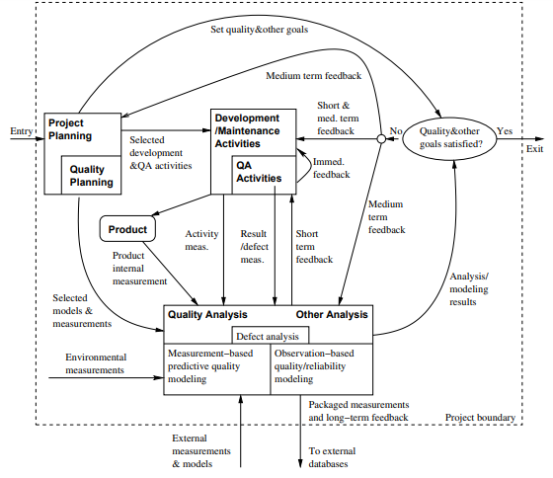
Feedback Loop Implementation
Notes:
• Overall implementation: Fig 18.2 (p.315) . Originated from Fig 5.1 . Via intermediate refinement in Fig 18.1

Slide 24
Implementation Support Tools
Type of tools:
Data gathering tools.
Analysis and modeling tools.
Presentation tools.
Data gathering tools:
Defects/direct quality measurements:
from defect tracking tools.
Environmental data: project db.
Activity measurements: logs.
Product internal measurements:
commercial/home-build tools.
New tools/APIs might be needed.

Slide 25
Implementation Support Tools
Analysis and modeling tools:
Dedicated modeling tools:
e.g., SMERFS and CASRE for SRE
General modeling tools/packages:
e.g., multi-purpose S-Plus, SAS.
Utility programs often needed for data screening and processing.
Presentation tools:
Aim: easy interpretation of feedback ⇒ more likely to act on.
Graphical presentation preferred.
Some “what-if”/exploration capability.

Slide 26
Strategy for Tool Support
Using existing tools ⇒ cost↓:
Functionality and availability/cost.
Usability.
Flexibility and programmability.
Integration with other tools.
Tool integration issues:
Assumption: multiple tools used. (All-purpose tools not feasible/practical.)
External rules for inter-operability,
common data format and repository.
Multi-purpose tools.
Utilities for inter-operability.

Slide 27
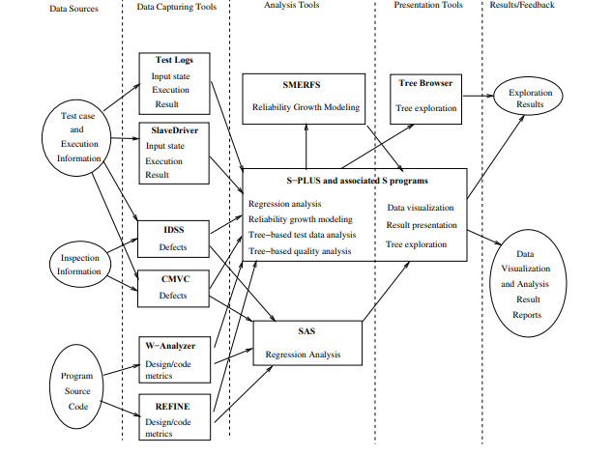
Tool Support Example
Notes:
• IBM example: Fig 18.3 (p.319).

Slide 28
That is all
Notes:
Data flow coverage link
https://www.cs.wm.edu/~kemper/cs435/slides/l15.pdf

